Slide 1

servers
Notes:
BRIAN:
Quick intro to serverless
Maturity model
Wardley map, discussion on utilities
Benefits / ideas about how this changes everything
Adoption ideas
Focus on high value changes
Challenges to implement
Experiences at GameStop

Slide 2



Jack Warner
jack.warner@parivedasolutions.com
/jackwarner
Phillip Manwaring
phillip.manwaring@parivedasolutions.com
/manwaring
Notes:
BRIAN

Slide 3


f(n) + +
Notes:
JACK
Yes, there are still servers.
And ‘serverless’ is such a popular term that it’s taking on a life of its own.
What we are talking about when we talk serverless:
Short lived functions measured in seconds or fractions of second)
Platform compute (not limited to public cloud)
Tools/frameworks to support development

Slide 4


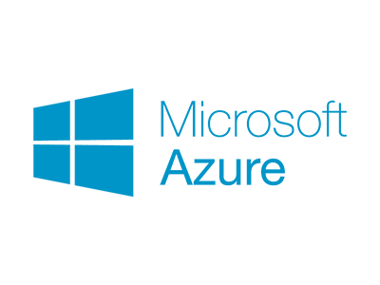


f(n) + +
Notes:
JACK
Compelling offerings in the space, and what we have experience with
So those are technologies. But our hypothesis is about serverless market offerings. It’s actually a bit broader. To take us our hypothesis.
PASS
PHILLIP – We’re pumped about this.

Slide 5
Your business doesn’t have technology problems
Notes:
PHILLIP

Slide 6


Slide 7


Slide 8
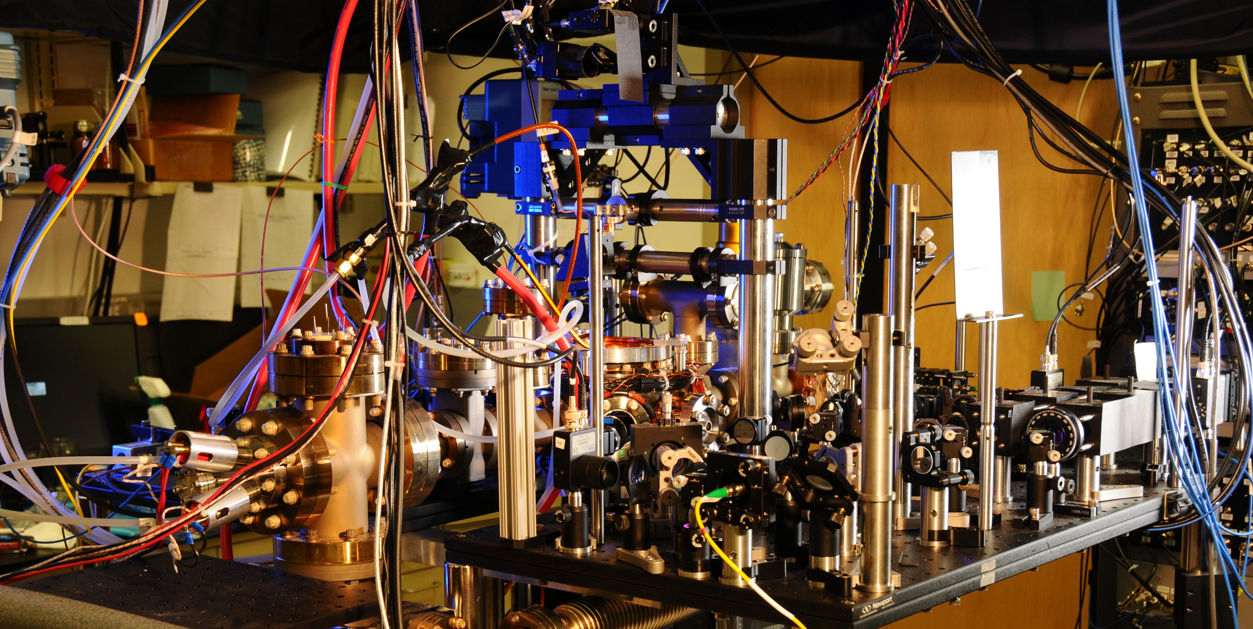
Notes:
Spanner ( Google’s modern relational database management systems that seek to provide the same scalable performance of NoSQL systems for online transaction processing (OLTP) read-write workloads while still maintaining the ACID guarantees of a traditional database system.^{[)1][2][3])}

Slide 9
You still have problems

Slide 10


Slide 11


Slide 12


Slide 13
You don’t have technology problems
Solving technology problems isn’t your business

Slide 14





20 - 40%
40 - 60%
60 - 80%
Notes:
PHILLIP:
What percentage of your IT organization’s time is spent on solving business problems?

Slide 15
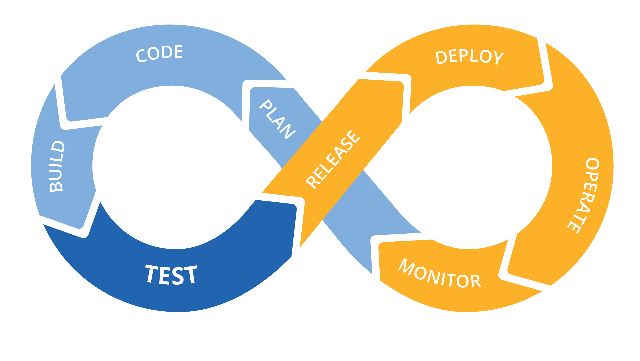
We have nothing new to offer
Notes:
PHILLIP:
Infrastructure automation paired with teams that support what they build isn’t new. This is DevOps, started to gain traction X years ago.
Infrastructure as code
CI/CD for increased speed and stability
Monoliths to microservices to functions
Small teams, highly cohesive and loosely coupled
Only pay for what you use
Polyglot – the right language/framework for the job

Slide 16
Energy
 | Time
Notes:
PHILLIP
What is new is this. Any associations? Drawing a blank? Can you smell the bunson burners from high school chemistry class?

Slide 17



Energy
 | Time
Activation energy
Notes:
This is a graph showing a chemical reaction.

Slide 18
Technology problems
 | Time
Difficulty of the change
Time required for change

Slide 19
Technology problems
 | Time
Catalysts change the equation

Slide 20
Technology problems
 | Time
Serverless
is the catalyst
Catalysts change the equation

Slide 21

(not very) Bold predictions
Notes:
ALT 1: If serverless a catalyst, what changes? Well, you’ll notice these changes right away.
ALT 2: Restate our hypothesis, now we want to get into the meat of this idea, which are some concrete ways your IT organization can start to benefit, and is to likely to change, as a result of this new way of doing business.

Slide 22


Slide 23

Notes:
Reduces friction, helps you do the right thing

Slide 24

Small, product focused teams
Notes:
Bedrock of DevOps movement is small, embedded team that support what they build.
Adoption is not the same as adopting a new dev toolkit. It’s organizational.
If you have a DevOps department, you might be doing it wrong.

Slide 25

Notes:
No more death star projects

Slide 26

Data driven decision making

Slide 27

Faster Time-to-Market
Notes:
Time to market

Slide 28

Notes:
Now you’ve figured out DevOps, and it didn’t hurt that much, did it?
Let’s consult the crystal ball to find out what kind of business opportunities await?

Slide 29


Notes:
The temptation of thwarting Brooks’ law will be a thing of the past.
Ramp up time eased by a more uniform style of dev/ops/deploy and access to production-like resources
Communication overheads reduced by the small, product-based teams we talked about before
Limited divisibility of tasks – serverless lends itself to a microservices architecture – divisibility of tasks is ‘out-of-the-box’ in this new world

Slide 30


Notes:
Accelerated IT ecosystem diversity.
You’ve heard ‘we’re a .NET shop, or we’ve standardized everything on Java’
This makes sense – it allows for uniform support when your highly paid designers and devs go on the next project, passing support off to a different set of people with different capabilities.
Standardization also makes ensuring your overall enterprise architecture doesn’t fly off the rails.
In a serverless world, security contracts should be in code, transparent, and enforced at deploy time.
IT Governance will get more effective while cost becomes constant.
The decoupling of governance costs from app dev removes the primary motivation for standardization. Don’t be surprised if a couple years from now, your running a Java function right next to a Haskall function.

Slide 31

Notes:
PHILLIP:
If relying on large efforts to change the organization and add business value, putting all your eggs in a single basket
Implies being able to clearly see the end from the beginning
Huge opportunity cost
Feel your way along and change to what’s working better

Slide 32
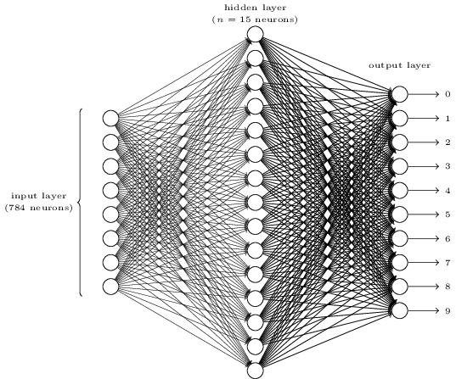
Notes:
In Phillip’s story, you needed the heroic experimenter.
In the future, when
serverless is the norm,
usage data is granular, abundant, and accessible, and
machine learning moves further into the commodity space
The heroic experimentor will be the machine. The idea of software products and services assembling themselves based on ML models isn’t quite as crazy as it sounds.

Slide 33
? ? ?

Slide 34

Technology problems
 | Time

Slide 35


Technology problems
 | Time
Notes:
Serverless is a unique opportunity to free your people’s brains to solve business problems instead of IT problems

Slide 36




Notes:
If the people you’ve hired have built a mature DevOps and cloud company they already know about serverless and love it, and probably are already using it
If the people you’ve hired haven’t built a mature DevOps and cloud company
If they would like to but can’t for whatever reasons, they likely know about serverless and have used it on side projects and love it
If they aren’t pushing for DevOps or cloud there’s a good chance they don’t know anything about serverless (or DevOps practices in general)
Know the group you are working with

Slide 37








